Slide 1
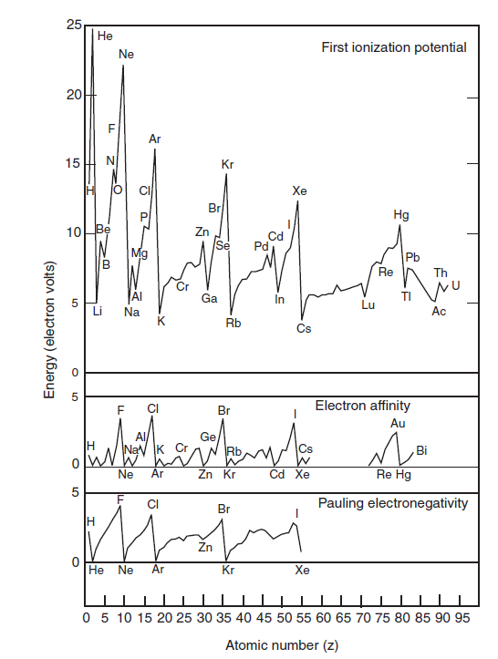
Properties of the elements

Slide 2
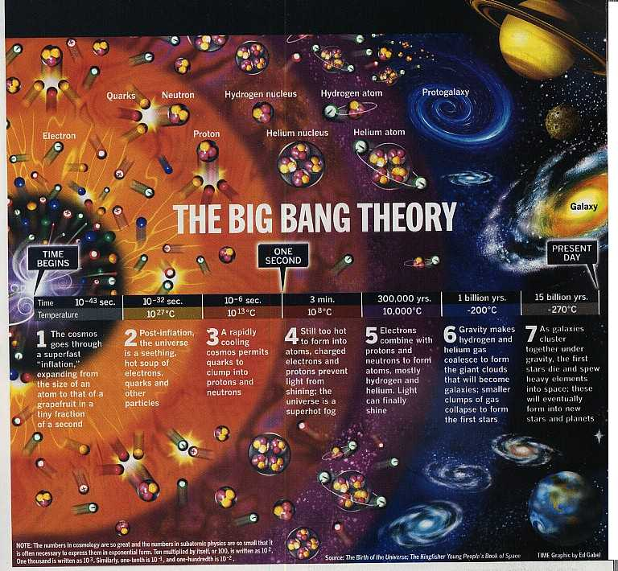

Slide 3
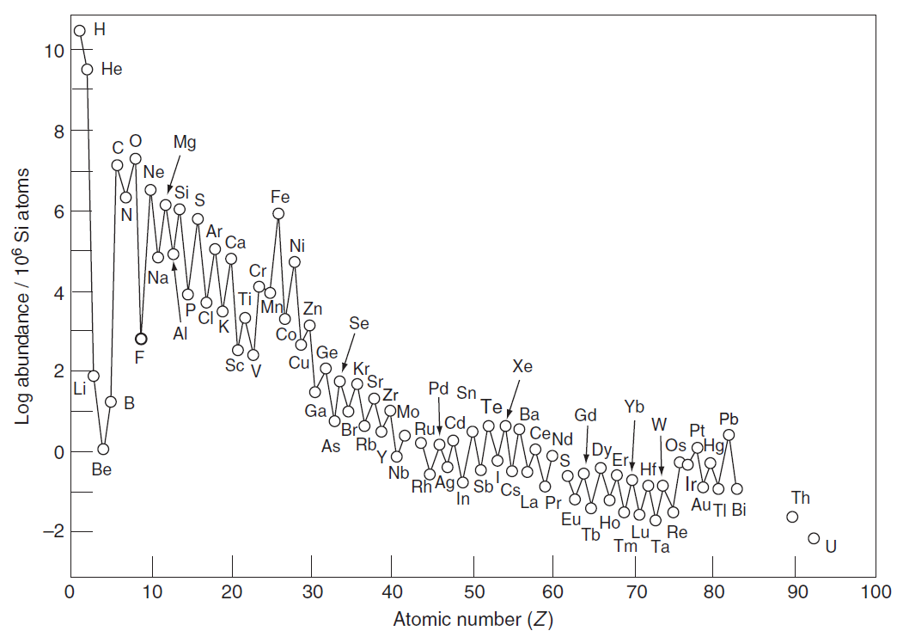
Solar system aabundance of the Elements

Slide 4
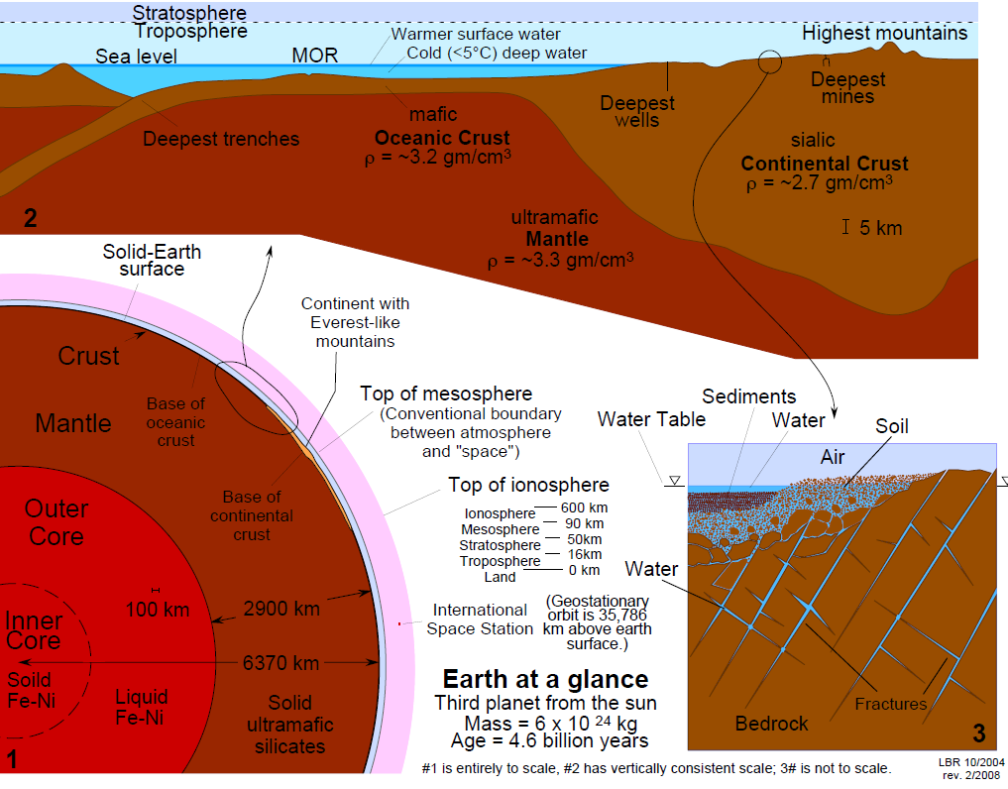

Slide 5












Abundance of the Elements
The diagram below shows the relative abundance of the elements in the cosmos and in Earth’s crust.
10
9
8
7
6
5
4
3
2
1
0
-1
-2
H
He
Log atomic abundance per 10⁶ atoms of Si
C
O
Ne Mg Si _{S}
N
Ar
Ca
Cr
Ti
Fe
Ni
Na
Al P
Notable crustal depletion of non-gas elements relative to cosmic abundance
F
Cl
Zn
7
6
5
4
3
2
1
0
-1
-2
-3
Li
O
Si
V
Ge
Se
Kr Sr
Zr
B
Ca
Fe
Mo
Pd
Te Xe
Cosmic Abundance
Pb
H
K
Ga
Rb
Sn
Ba
La
Dy
Os
Hf
Pt
Mg
P
Ti
As
Nb
Sr _{Zr}
Ir
C
In
Sb
Eu
Re
Bi
S
Zn
Ba
Lu
N
Cr
_{Co} Cu
Br Y
Nd
Gd
Be
Sc
Ru _{Pd}
Sn
La
Er
Hf
(He)
Ge
Mo
Tl
Pb
Th
(Ne)
Crustal
W
U
Se
Abundance
Bi
(Ar) Ag In
0 5 10 15 20 25 30 35 40 45 50 55 60 65 70 75 80 85 90 95
(Kr) (Xe)
Au Hg
Z (atomic number)
Cosmic abundances are from Ahrens, L.H., 1965, Distribution of the Elements in our Planet: New York, McGraw-Hill, 110 p.; Crustal abundances are from Krauskopf, K.B., 1979, Introduction to Geochemistry (2nd edn.): New York, McGraw Hill, 617 p.

Slide 6
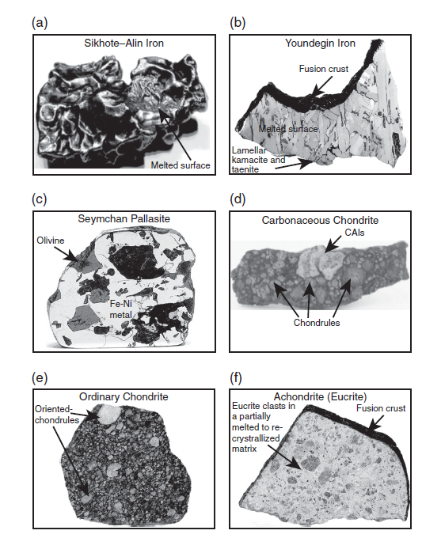

Slide 7
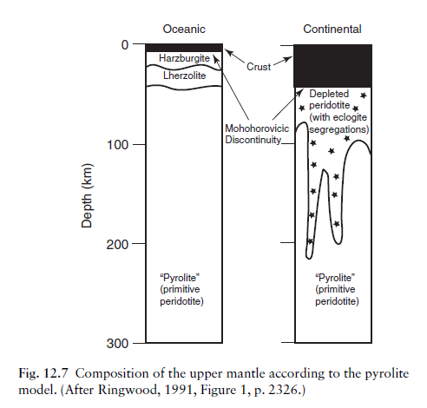

Slide 8
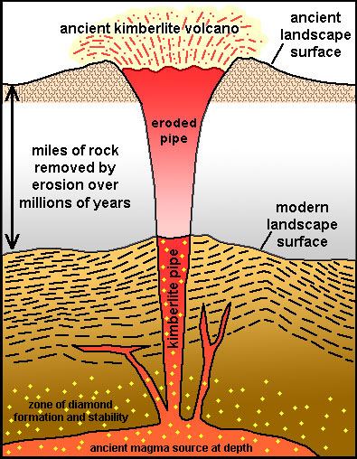

Slide 9
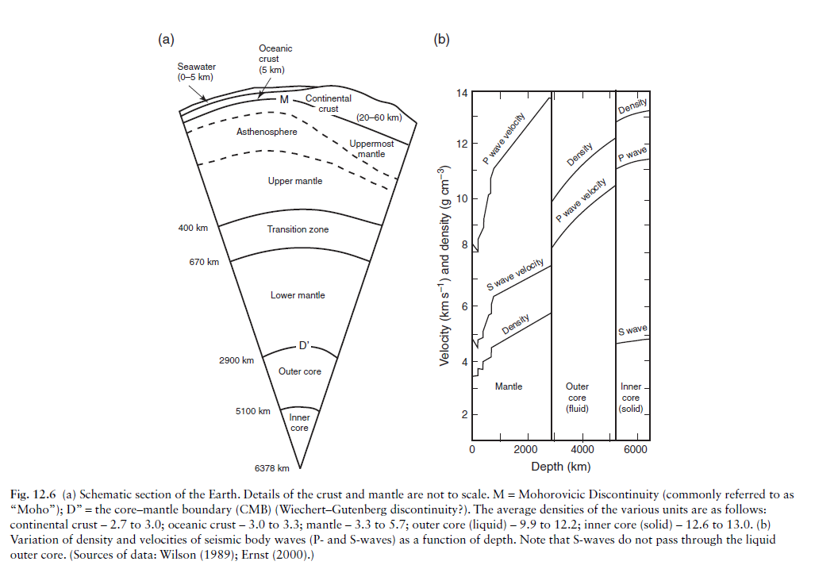

Slide 10
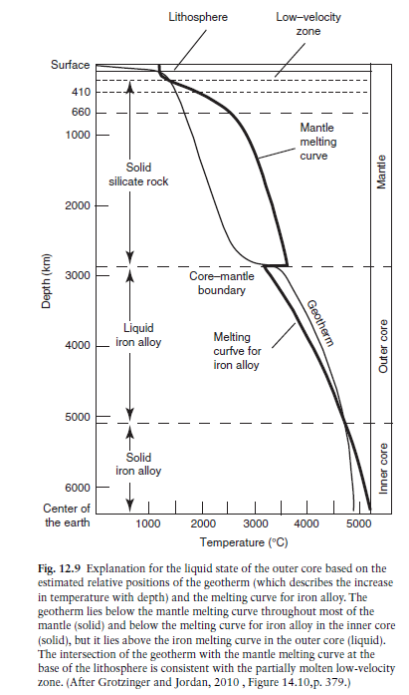

Slide 11
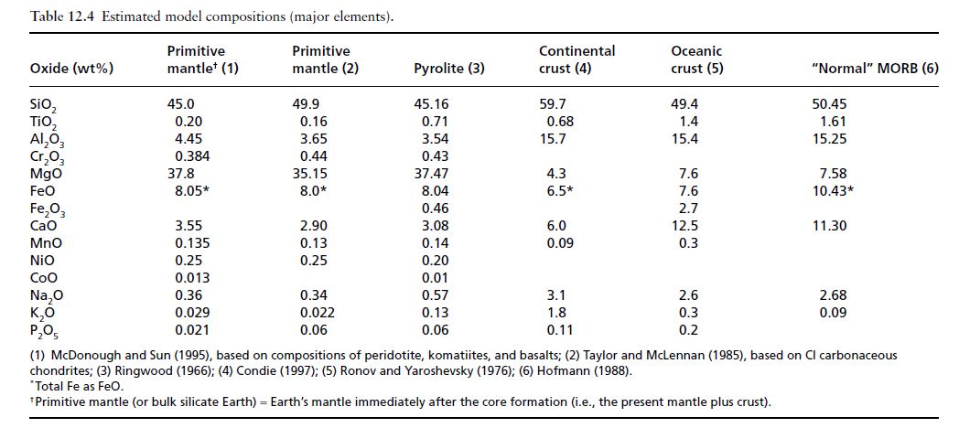

Slide 12
